Slide 1


SOFTWARE Design & Analysis (Week-12)
Usama Musharaf
MS-CS (Software Engineering)
Lecturer (Department of Computer Science)
FAST-NUCES Peshawar

Slide 2
Agenda of Week # 12
Graphical User Interface
Awt vs Swing
GUI creation Steps
Code

Slide 3
A graphical user interface (GUI) presents a user-friendly mechanism for interacting with an application.
A GUI gives an application a distinctive “look and feel.”
GUIs are built from GUI components.
These are sometimes called controls or widgets—short for window gadgets.
A GUI component is an object with which the user interacts via the mouse, the keyboard or another form of input, such as voice recognition.

Slide 4
SIMPLE GUI-based Input/Output with JOptionPane

Slide 5
Most applications you use on a daily basis use windows or dialogboxes (also called dialogs) to interact with the user.
Dialog boxes are windows in which programs display important messages to the user or obtain information from the user.
Java’s JOptionPane class (package javax.swing) provides prebuilt dialog boxes for both input and output.
These are displayed by invoking static JOptionPane methods.

Slide 6
Lets Code!

Slide 7
import javax.swing.JOptionPane;
public class Addition {
public static void main(String[] args) {
String firstNumber = JOptionPane.showInputDialog( "Enter first integer" );
String secondNumber = JOptionPane.showInputDialog( "Enter second integer" );
int number1 = Integer.parseInt( firstNumber );
int number2 = Integer.parseInt( secondNumber );
int sum = number1 + number2;
JOptionPane.showMessageDialog( null, "The sum is " + sum, "Sum of Two Integers", JOptionPane.PLAIN_MESSAGE );
}
}

Slide 8
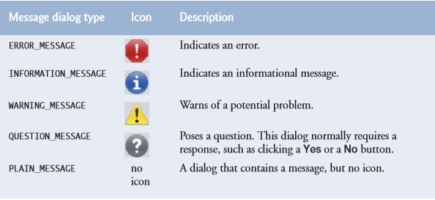

Slide 9
Overview of Swing Components

Slide 10
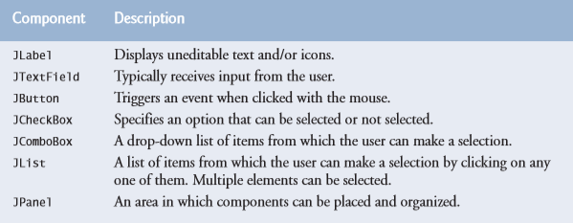
It’s possible to perform input and output using the JOptionPane dialogs, most GUI applications require more elaborate user interfaces.

Slide 11
Swing VS AWT

Slide 12
AWT:
There are actually two basic sets of Java GUI components.
In Java’s early days, GUIs were built with components from the Abstract Window Toolkit (AWT) in packagejava.awt.
AWT stands for “Abstract Windowing Toolkit “contains original GUI components that came with the first release of JDK.
These components are tied directly to the local platform’s (Windows, Linux, MAC etc) graphical user interface capabilities.
Thus results in a java program executing on different java platforms (windows, Linux, Solaris etc) has a different appearance and sometimes even different user interaction on each platform.

Slide 13
SWING:
Swing components are written, manipulated and displayed completely in java, therefore also called pure java components. The swing components allow the programmer to specify a uniform look and feel across all platforms

Slide 14
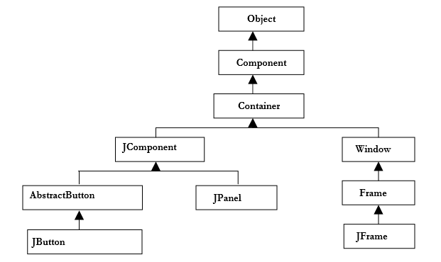
Framework Hierarchy:

Slide 15
GUI Creation Steps:
Import required packages
Set the top-level container
Get the component area of top-level container
Apply Layout to the area
Create and add components
Set size of frame and make it visible

Slide 16
1. Import required packages
import java.awt.*;
Import javax.swing.*;

Slide 17
2. Set the top-level container
A container is a collection of related components, which allows other components to be nested inside it.
In application with JFrame, we attach components to the content pane – a container.
Two important methods the container class has add and setLayout.
JFrame frame = new JFrame();

Slide 18
3. Get the component area of top-level container
The Component Area often known as Client area is a workable place for the programmer.
Components can be added/removed in this area. So, to add components, as you guessed right component area of the JFrame is required. It can be accomplished by the following code of line.
Conntainer con = frame.getContentPane();
frame is an instance of JFrame and by calling getContentPane() method on it, it returns the component area. This component area is of type container and that is why it is stored in a variable of a Container class. As already discussed, container allows other components to be added / removed.

Slide 19
4. Apply Layout to the area
The layout (size & position etc. How they appear) of components in a container is usually governed by Layout Managers.

Slide 20
5. Create and Add components
Create required components by calling their constructor.
JButton button = new JButton ( );

Slide 21
6. Set Frame Size
A frame must be made visible via a call to setVisible(true) and its size defined via a call setSize(rows in pixel, columns in pixel) to be displayed on the screen.
frame.setSize(200, 300) ;
frame.setVisible(true) ;

Slide 22
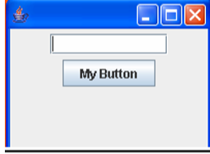
Making a simple GUI:

Slide 23
Lets Code!

Slide 24
Layout Managers:
1. Flow Layout
2. Grid Layout
3. Border Layout
4. Box Layout
5. Card Layout
6. GridBag Layout and so on

Slide 25
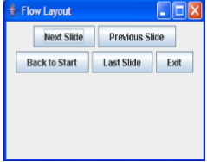
1. Flow Layout:
Position components on line by line basis. Each time a line is filled, a new line is started.
The size of the line depends upon the size of your frame.

Slide 26
Lets Code!

Slide 27
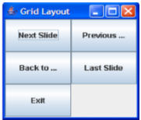
2. Grid Layout:
Splits the panel/window into a grid (cells) with given number of rows and columns.
Size of each component is same
Components are added row wise.
When all the columns of the first row are get filled the components are then added to the next row.
Only one component can be added into each cell.

Slide 28
Lets Code!

Slide 29
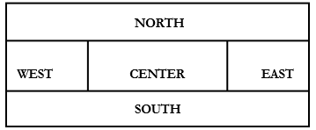
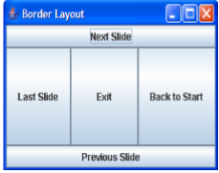
3. Border Layout:
Divides the area into five regions. North, South, East, West and Center
Components are added to the specified region
If any region not filled, the filled regions will occupy the space but the center region will still appear as background if it contains no component.
Only one component can be added into each region.

Slide 30
Lets Code!

Slide 31
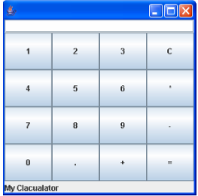
Calculator GUI
Which Layout is suitable for this GUI ?

Slide 32
JPanel
It is general purpose container (can’t exist alone).
It has to be in some top-level container) in which we can put in different components like
JButton ,
JTextField etc even other JPanel.

Slide 33
Lets Code!

Slide 34
HAVE A GOOD DAY!

